Slide 1

California House Price Prediction
Aaila Mehmood
500869338

Slide 2
Introduction
Dataset contains information from 1990 California census
Regression Problem – build a model to predict California house prices
Contains 20,640 row and 10 columns

Slide 3
Quick Look at the Data
A look at the top 5 rows of data
Each row represents a district
9 numerical variables
1 categorical variable ocean proximity, containing 5 categories
<1H OCEAN INLAND ISLAND NEAR BAY NEAR OCEAN
longitude <dbl> | latitude <dbl> | housing median age <dbl> | total rooms <dbl> | Total bedrooms <dbl> | population <dbl> | House-holds <dbl> | Median income <dbl> | Median House value <dbl> | Ocean proximity <fctr>
-122.23 | 37.88 | 41 | 880 | 129 | 322 | 126 | 8.3252 | 452600 | NEAR BAY
-122.22 | 37.86 | 21 | 7099 | 1106 | 2401 | 1138 | 8.3014 | 358500 | NEAR BAY
-122.24 | 37.85 | 52 | 1467 | 190 | 496 | 177 | 7.2574 | 352100 | NEAR BAY
-122.25 | 37.85 | 52 | 1274 | 235 | 558 | 219 | 5.6431 | 341300 | NEAR BAY
-122.25 | 37.85 | 52 | 1627 | 280 | 565 | 259 | 3.8462 | 342200 | NEAR BAY
Notes:
A district is the smallest geographical unit for which the US Census Bureau publishes sample data, typically with a population of 600 to 3,000 people

Slide 4
Histogram of all variables
Notes:
A quick look at the type of data we’ll be dealing with.
Very different scales
Housing_median_age and median_house_value are capped

Slide 5
View Correlations – Correlation Matrix

Slide 6
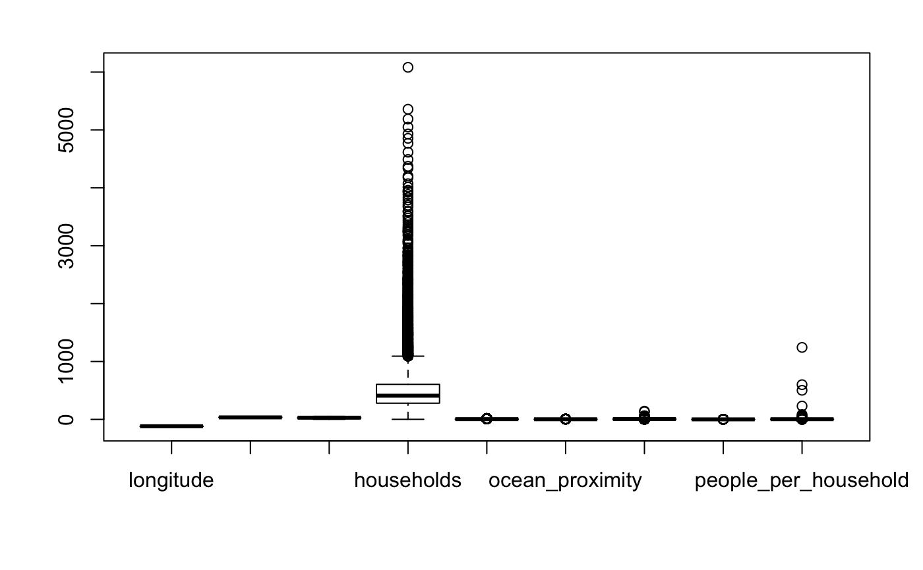
Boxplot
Boxplot

Slide 7
Data Preparation – Part 1
Missing Values
207 missing values in the variable total_bedrooms
Missing values imputed using Knn-imputation
Converting district statistics to per household statistics:
People_per_household = population / households
Mean_rooms = total rooms/ households
Mean_bedrooms = total bedrooms/ total_rooms
Notes:
A district is the smallest geographical unit for which the US Census Bureau publishes sample data, typically with a population of 600 to 3,000 people

Slide 8
Data Preparation – Part 2
Convert categorical variables to numeric:
Remove outliers
Data normalization
Train – test Split (70% – 30%)
Level | <1H OCEAN | INLAND | ISLAND | NEAR BAY | NEAR OCEAN
Label | 1 | 2 | 3 | 4 | 5

Slide 9
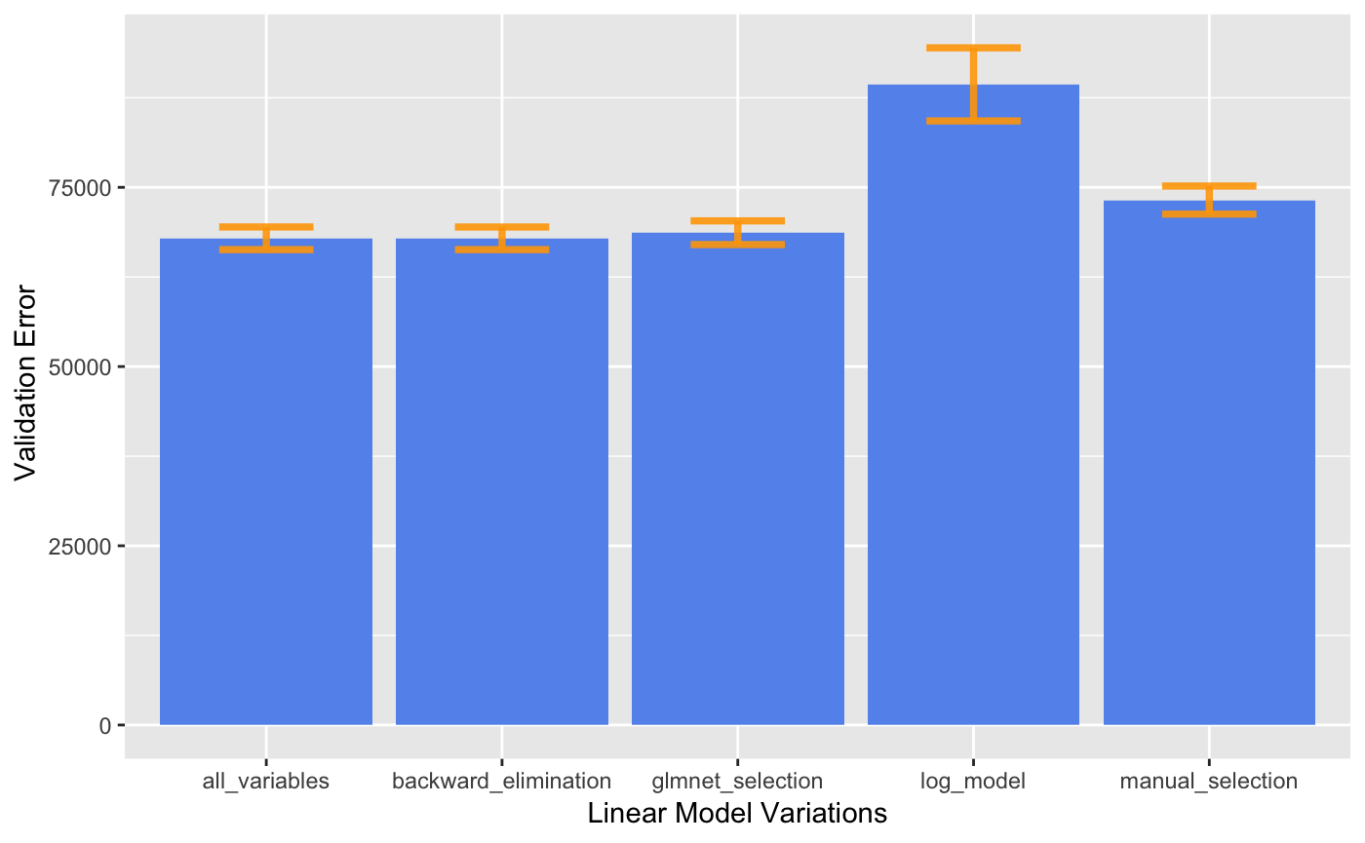
Train Model – Multiple Linear Regression
Attribute selection and model building using 10-fold cross validation
All attributes
Forward Selection /Backward Elimination
Glmnet package for feature selection
Manual feature selection
Log of target variable
Choose best model:
Least validation set RMSE with
Backward elimination
RMSE = 67,888
Notes:
Now the data is prepared and we can select and train ML models.

Slide 10
Multiple Linear Regression – cont’d
Coefficient obtained
Median income, people per household and longitude have the highest coefficients
Independent Variable | Coefficient
Intercept | 345,019
Longitude | -409,363
Latitude | -386,118
Housing_median_age | 57,500
Households | 47,288
Median_income | 616,443
Mean_rooms | 249,772
Mean_bedrooms | 316,563
People per household | -476,705

Slide 11
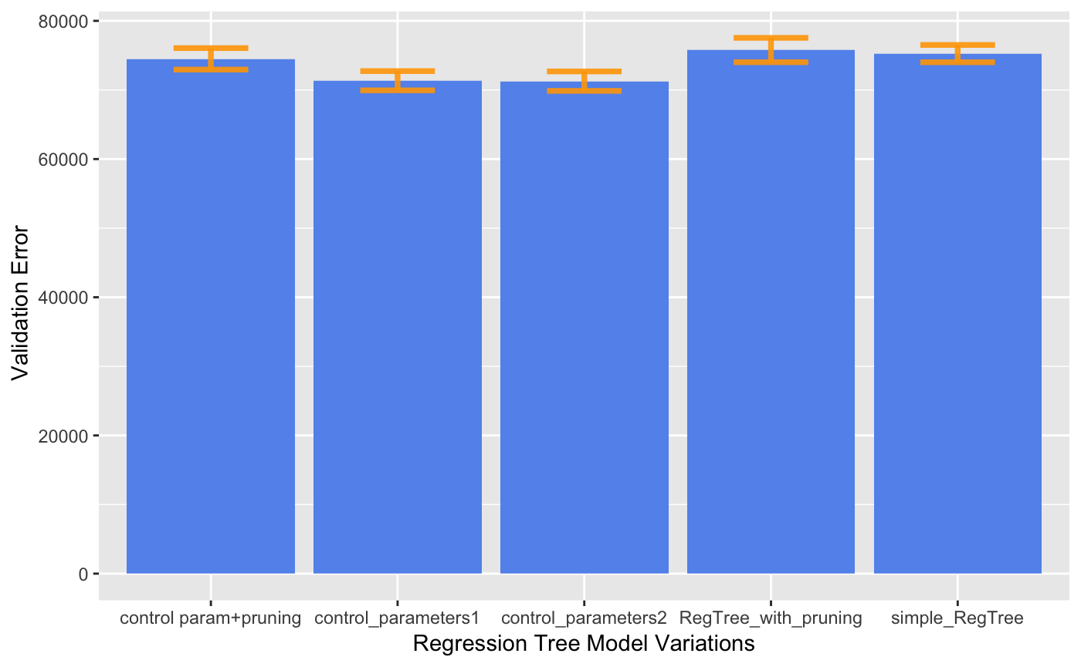
Train Model – Regression Tree
Hyperparameter tuning and train model using 10-fold cross validation
Regression tree with default settings
Pruned regression tree
Tuning hyperparameters ”minsplit” and ”cp”
Pruned tree with hyperparameter tuning
Choose best model:
Minsplit = 1000, cp = 0.0001
RMSE = 71,271
Notes:
Cp = complexity parameter. Any split that does not decrease the overall lack of fit by a factor of cp is not attempted.

Slide 12
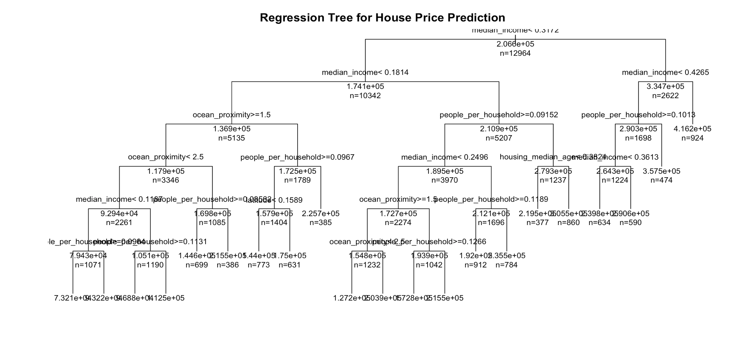
Regression Tree
District median income, people per household and ocean proximity are the most important parameters for data partitioning

Slide 13
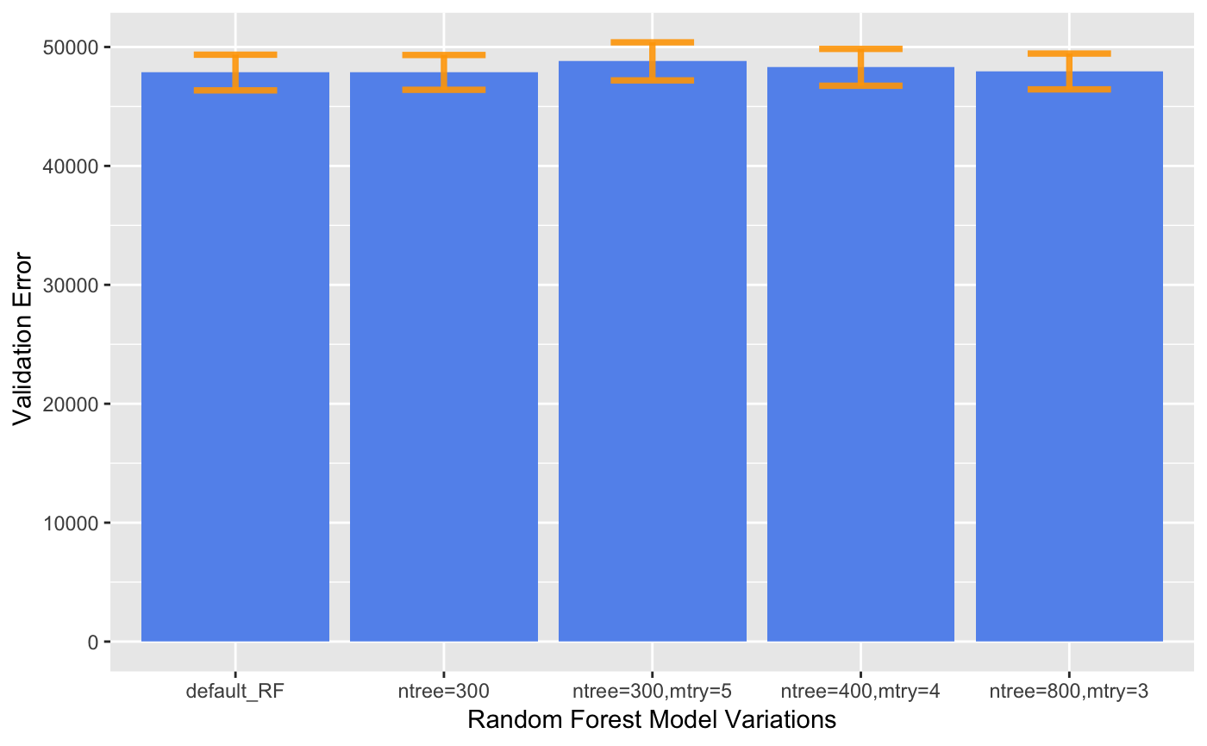
Train Model – Random Forest
Hyperparameter tuning and train model using 10-fold cross validation
Random forest with default settings
Random forest with different values for hyperparameter “ntree” and ”mtry”
Choose best model:
With default setting
(ntree=500, mtry = 3)
RMSE = 47,853

Slide 14
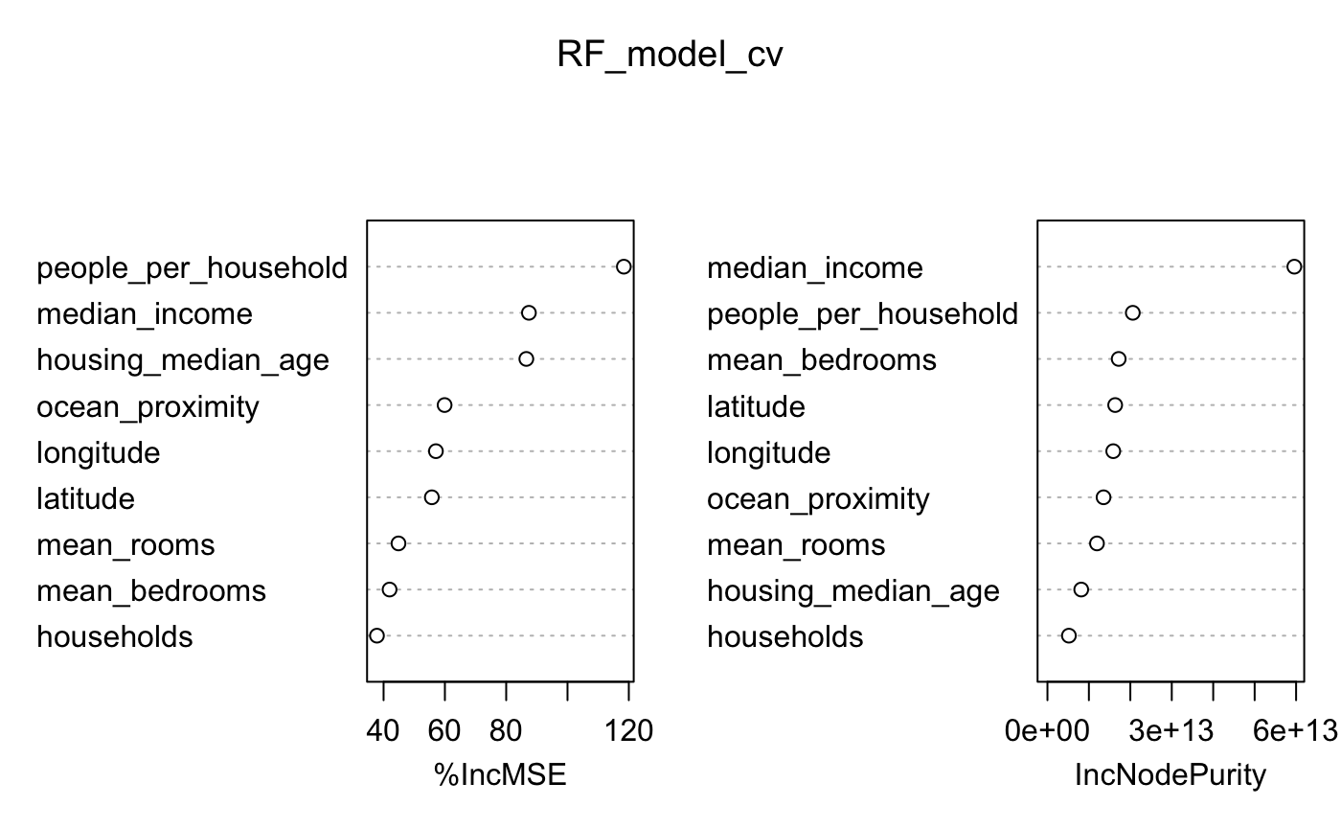
Random Forest
Variable importance
District median income and people per household are the two most important variables

Slide 15
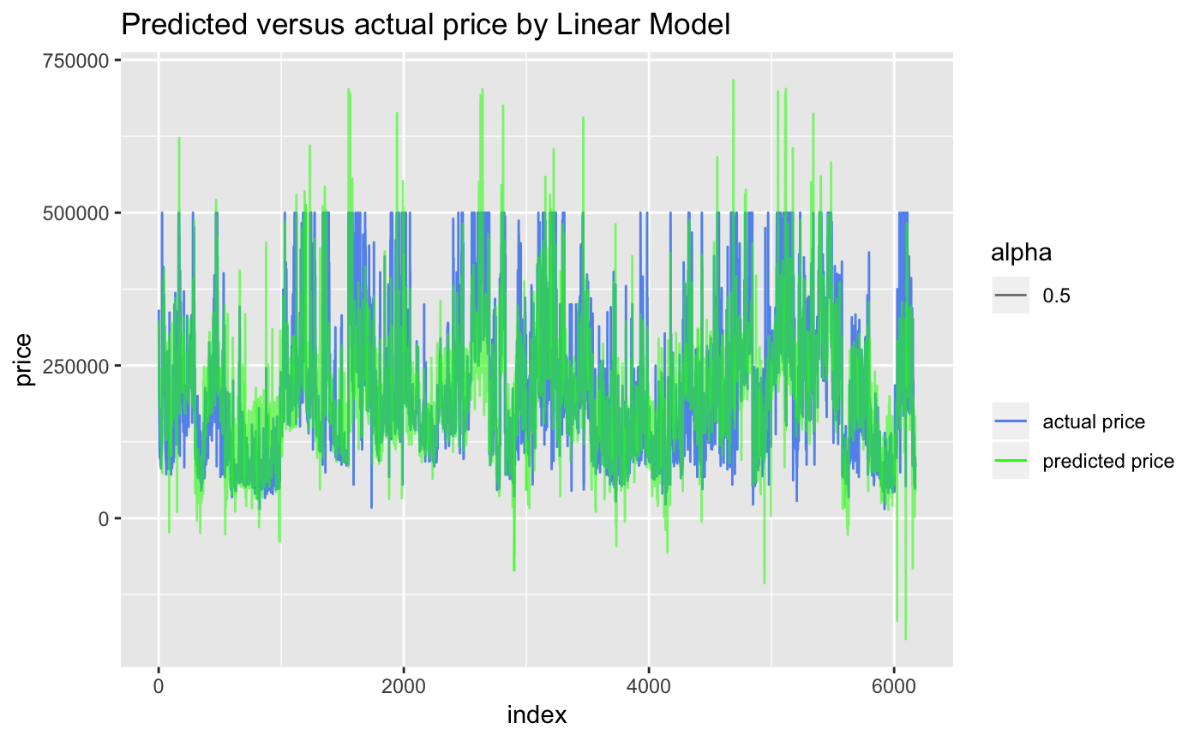
Test Linear Regression Model
RMSE = 67,843 %MAE= 29.7

Slide 16
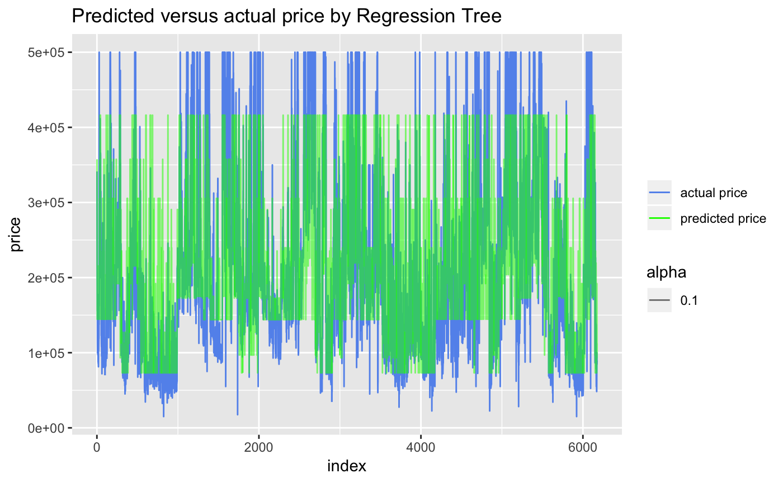
Test Regression Tree Model
RMSE = 72,779 %MAE = 29.7

Slide 17
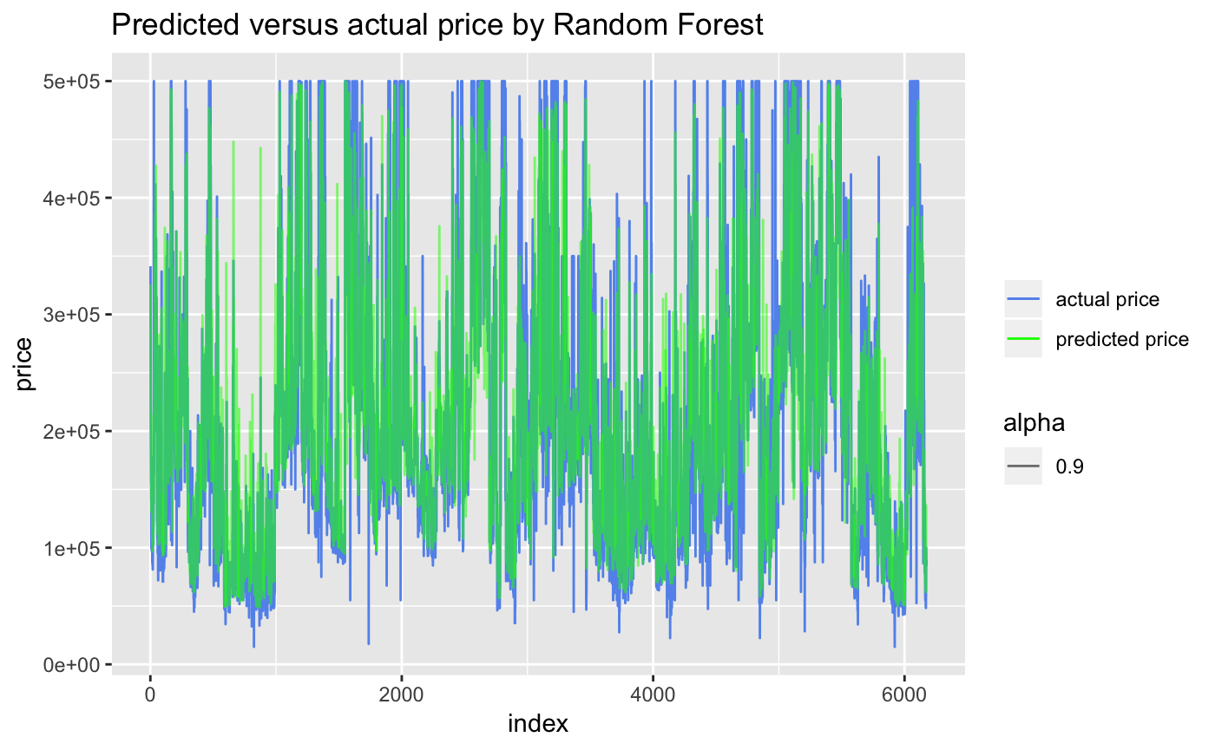
Test Random Forest Model
RMSE = 48,584 %MAE = 18.2

Slide 18
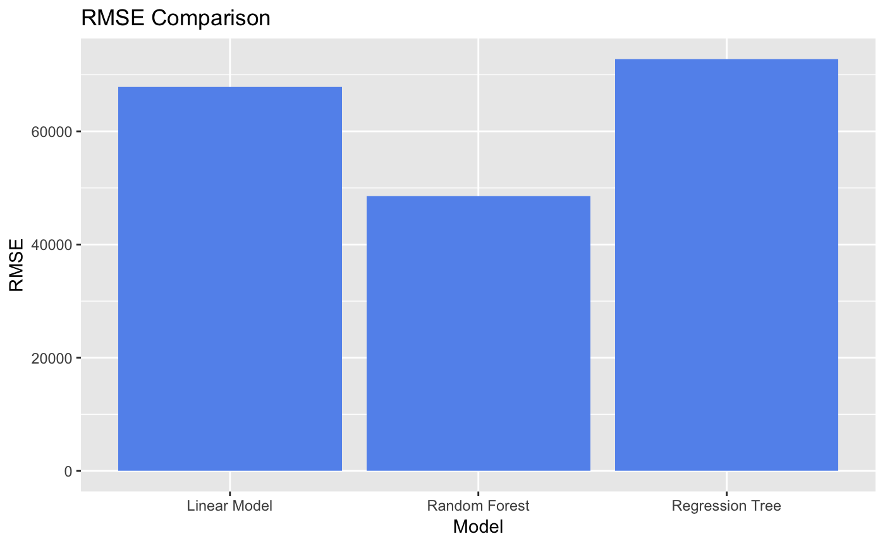
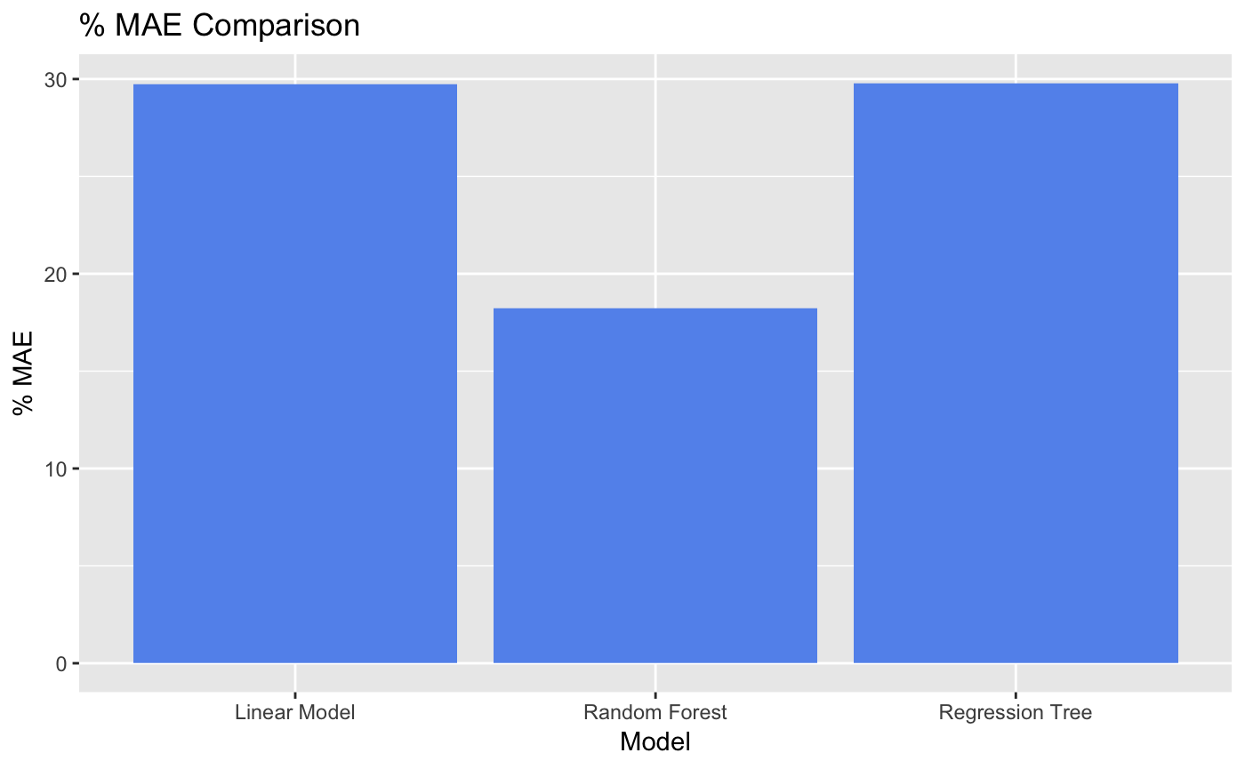
Evaluate Model
Comparison of the three models
Model | RMSE | % MAE
Linear Regression | 67,843 | 29.7
Regression Tree | 72,779 | 29.7
Random Forest | 48,584 | 18.2

Slide 19
Conclusion
Random Forest is the most suitable model for the house price prediction
Its prediction is within 18% of actual sales price.
District median income and people per household are the two most important predictor variables in predicting house prices.

Slide 20
Q&A
Thank you

